Slide 1
Software Testing
Chapter 3 White-Box Testing

Slide 2

Contents
White-Box Testing
3.1 Basic Concepts
3.2 Logic Coverage
3.3 Control Flow Graph
3.4 Basis Path Testing
3.5 Loop Testing
3.6 N-S Graph
3.7 A Comparison of White-box Testing and Black-box Testing
Chapter 3

Slide 3
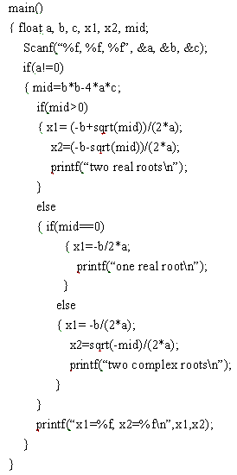
Review
1
9
1
2
2
8
3
3
4
5
6
4
7
7
5
8
6
9
Notes:
可能会有不同的画法，比如7、8被省略了，无所谓，不会影响最终的复杂度计数。

Slide 4
Review
Start
A
Exercise:
  Cyclomatic complexity?
  Identifying independent paths?
  *if there is “switch-case”:
  complexity=
  #predicated nodes+1+#cases-2
B
C
D
E
F
G
End

Slide 5
3.5 Loop Testing
Focuses exclusively on the validity of loop constructs.
Types of Loop
  Simple Loops
  Nested Loops
  Concatenated Loops
  Unstructured Loops
Notes:
Can be categorized in Control Structure Testing
循环测试，白盒测试的一种，注重循环构造的有效性，四种循环：简单循环，嵌套循环，串接循环，不规则循环
Concatenated concatneitid

Slide 6
Nested Loops
Simple Loops
Concatenated Loops
Unstructured Loops

Slide 7
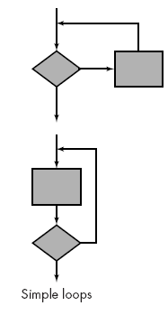
3.5 Loop Testing- Simple Loops
The following set of tests can be applied to simple loops, where n is the maximum number of allowable passes through the loop
  Skip the loop entirely.
  Only one pass through the loop.
  Two passes through the loop.
  m passes through the loop where m < n.
  n-1, n, n+1 passes through the loop
Notes:
简单循环： 下列测试集用于简单循环，其中n是允许通过循环的最大次数。
整个跳过循环；
只有一次通过循环；
两次通过循环；
m次通过循环，其中m<n；
n-1，n,n+1次通过循环。（边界值）

Slide 8
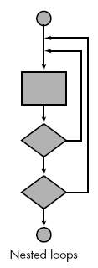
3.5 Loop Testing- Nested Loops
Start at the innermost loop. Set all other loops to minimum values.
Conduct simple loop tests for the innermost loop while holding the outer loops at their minimum iteration parameter (e.g., loop counter) values.
Work outward, conducting tests for the next loop, but keeping all other outer loops at minimum values and other nested loops to "typical" values.
Continue until all loops have been tested.
Notes:
如果将简单循环的测试方法用于嵌套循环，可能的测试数就会随嵌套层数成几何级增加，这会导致不实际的测试数目，下面是一种减少测试数的方法：
从最内层循环开始，将其它循环设置为最小值；
对最内层循环使用简单循环，而使外层循环的跌代参数（即循环计数）最小，并为范围外或排除的值增加其它测试；
由内向外构造下一个循环的测试，但其它的外层循环为最小值，并使其它的嵌套循环为“典型”值；
继续直到测试所有的循环。

Slide 9
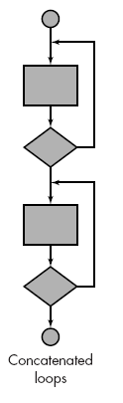
3.5 Loop Testing- Concatenated Loops
If each of the loops is independent of the other:
  Concatenated loops can be tested using the approach defined for simple loops,
Else
  the approach applied to nested loops is recommended.
Notes:
如果串接循环的循环都彼此独立，可是使用简单循环的策略测试。
但是如果两个循环串接起来，而第一个循环是第二个循环的初始值，则这两个循环并不是独立的。如果循环不独立，则推荐使用的嵌套循环的方法进行测试。

Slide 10
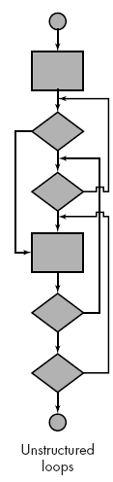
3.5 Loop Testing- Unstructured Loops
Whenever possible, this class of loops should be redesigned to reflect the use of the structured programming constructs
Notes:
不能测试，尽量重新设计给结构化的程序结构后再进行测试。

Slide 11

3.5 Loop Testing
Problems:
  1、For simple loops where n is the maximum number, how to test the (n+1)-th pass through the loop?
  2、For nested loops test, how to conduct simple loop tests for the innermost loop while holding the outer loops at their minimum (0 or 1) values?
Notes:
1 简单循环，如何测试n+1循环: 确保程序可以成功识别n+1，即不运行此次循环。
2 测试指导，简单测试内循环的时候，外循环的最小值是多少，1，0：如果有关联，就循环一次，否则为0

Slide 12
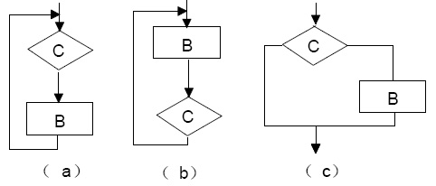
3.5 Loop Testing
The easy way to test loops is using the method Z path coverage.
Z path coverage method: Loop structure will be simplified into If structure.
Simplified cycle will be tested only once, or zero times. In this case, the effect of loop structure is equivalent to If branch, i.e. the loop body is executed or skipped.
Notes:
Z 路径覆盖法是一种将程序中循环结构简化成选择结构的测试方法。
循环简化的目的是限制循环次数，无论循环的形式和循环体实际执行的次数，简化后的循环测试只考虑循环一次或者零次两种情况。
在这种情况下，循环与判定分支的效果是一样的，即循环要么执行，要么跳过。

Slide 13
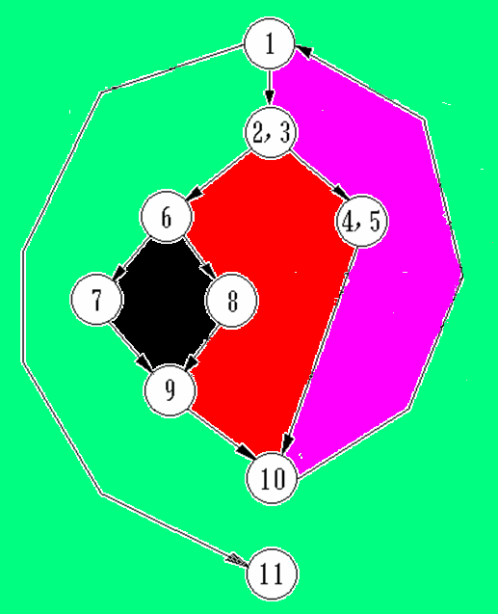
Z-path coverage:
  1->11
  1->2,3->6->8->9->10->1->11
R2
R2
R3
R1
R4

Slide 14
3.6 N-S graph
How many test cases are required at least for basis path testing?
  Draw the control flow graph
  Compute cyclomatic complexity
How many test cases are required at least for path coverage?
  Draw the N-S graph
  Compute #test cases
Notes:
简化问题，为避免出现测试用例过多的组合可能，把构成循环操作的重复型的用选择结构代替，只对循环检查一次，这样，任一循环都可以看出进入循环或不进去循环的分支操作；
这样，只考虑选择型的，
N-S图（盒图）的特性就像盒子一样，结构性很强。由于取消了流程线，象“goto”这样乱跳的语句，也就没有了表达的形式。所以，N-S图又被人称为是“结构化流程图”。也就是说，对于传统的流程图，结构化编程依赖于程序员的自觉自律；而对于N-S图，结构化编程则是由绘图规则来强制保证的。你想不结构化都不行，呵呵。N-S图除了表示几种标准结构的符号之处，不再提供其他如“流程线”这样的描述符号，这就有效地保证程序的质量。

Slide 15
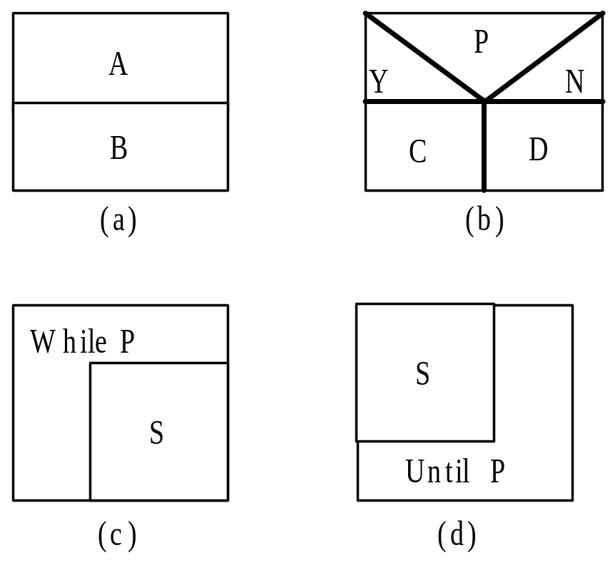
3.6 N-S graph
N-S graph (structured program without “goto”)
A、B、C、D、S
P: predication（Y or N ）
Notes:
简化问题，为避免出现测试用例过多的组合可能，把构成循环操作的重复型的用选择结构代替，只对循环检查一次，这样，任一循环都可以看出进入循环或不进去循环的分支操作；
这样，只考虑选择型的，
N-S图（盒图）的特性就像盒子一样，结构性很强。由于取消了流程线，象“goto”这样乱跳的语句，也就没有了表达的形式。所以，N-S图又被人称为是“结构化流程图”。也就是说，对于传统的流程图，结构化编程依赖于程序员的自觉自律；而对于N-S图，结构化编程则是由绘图规则来强制保证的。你想不结构化都不行，呵呵。N-S图除了表示几种标准结构的符号之处，不再提供其他如“流程线”这样的描述符号，这就有效地保证程序的质量。

Slide 16
3.6 N-S graph for Path Coverage
Example：
a or b: P1; c or d: P2
At least 4 test cases are required
2 × 2 = 4
    Combination of 2 predication sentences
    1 + 1 = 2 statements for each predication
P1
Y
N
a
b
P2
Y
N
c
d
Notes:
到

Slide 17
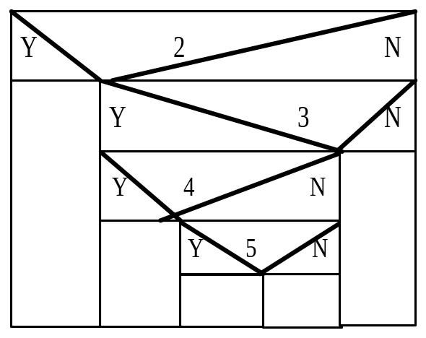
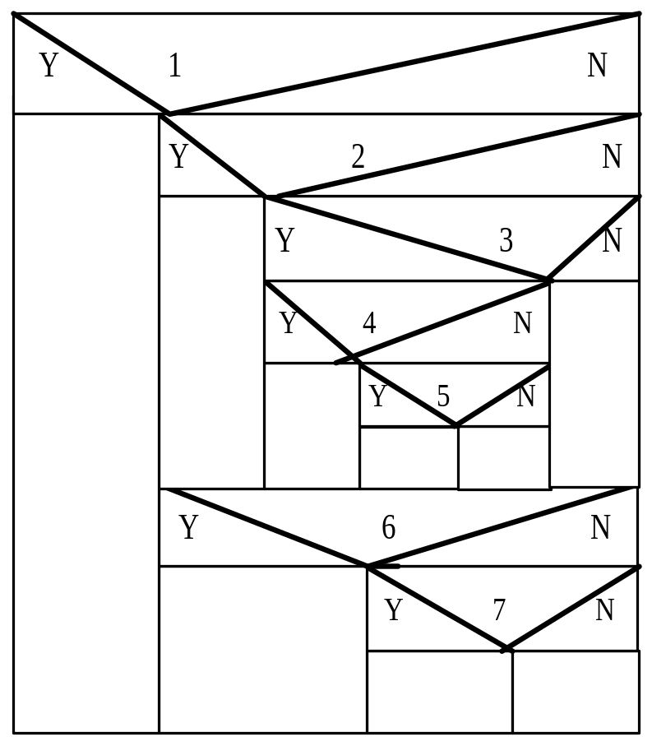
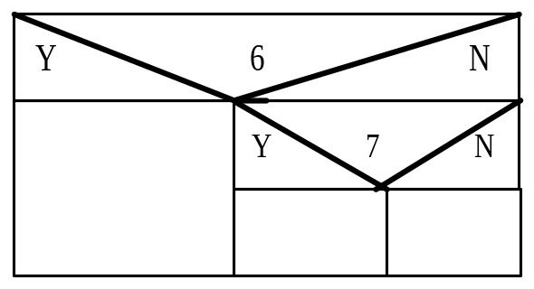
3.6 Examples
1+1+1+1+1=5
16
1+1+1=3
Notes:
一个path中，是否会被同时执行？

Slide 18
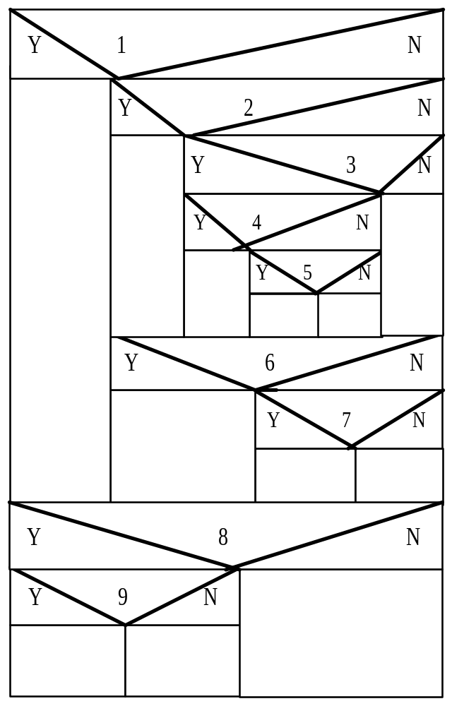
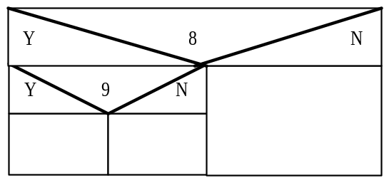
3.6 Examples
1+(3x5)=16
×= 48
1+1+1=3

Slide 19
3.7 A Comparison of White-box Testing and Black-box Testing
 | White-box Testing | Black-box Testing
Tester visibility | have visibility to the code and write test cases based upon the code | have no visibility to the code and write test cases based on possible inputs and outputs for functionality documented in specifications and /or requirements
A failed test case reveals controlled？ | a problem (fault) Yes – the test case helps to identify the specific lines of code involved | a symptom of a problem (a failure) No – it can be hard to find the cause of the failure
Notes:
测试者的可见性

Slide 20
3.7 A Comparison of White-box Testing and Black-box Testing
 | White-box Testing | Black-box Testing
Program structure | known | unknown
Workload | small | large
Based on? | Detailed design and implementation | Requirement document, general design
Test what? | Program structure | Input/output interfaces/functionality
Who? | programmers | testers
advantages | Test the specific module in the program | Test as the end-users
shortcomings | Whether or not the user requirements have been satisfied? | Implementation error? Wrong requirement description?

Slide 21
Course Overview-Class Hours
Class Hours: 80 (1-16 weeks)
Teaching: 32
(10:10-12:00 AM, Friday)
Experiments: 48
(13:30-16:20 PM, Tuesday, Lab:Hewlett-Packard)

Slide 22
Course Overview-Instructors
Teaching classes:
Zhigang Wang (王志刚) (1st-8th week)
Ruobing Jiang (蒋若冰) (9th-16th week)
Experiments:
Lin Ge (葛琳) (1st-16th week)
Contact me:
Office: Xinxi Building (Sourth) Room-B511
信息南楼B511
Email: wangzhigang@ouc.edu.cn

Slide 23
Course Overview-Grading Policy
In-class quiz: 10%
Experiments: 50%
Final Exam: 40%
(close-book or open-book exam?)
Notes:
Kwɪz
check class attendance

Slide 24
Thank you !

